Slide 1


Cloud Computing and Security
BIS613D
Module 4
Cloud Security and Trust Management
Department of ISE

Slide 2
CLOUD SECURITY AND TRUST MANAGEMENT
A healthy cloud ecosystem is desired to free users from violence, cheating, hacking, viruses, rumors, spam, and privacy and copyright violations.
The security demands of three cloud service models, IaaS, PaaS, and SaaS are based on various SLAs between providers and users.

Slide 3
CLOUD SECURITY AND TRUST MANAGEMENT
An example of a healthy cloud ecosystem is Google Workspace
a suite of cloud-based productivity tools like Gmail, Google Drive, Docs, and Meet which demonstrates many of the principles of a secure and respectful online environment.
Violence and Rumors
Google uses advanced content moderation and AI tools to detect and remove harmful or violent content in shared files and communications, especially in public documents and YouTube (part of its cloud offerings).
Cheating and Hacking
Strong multi-factor authentication (MFA), account activity alerts, and continuous security monitoring help protect users from unauthorized access.

Slide 4
CLOUD SECURITY AND TRUST MANAGEMENT
An example of a healthy cloud ecosystem is Google Workspace
Viruses and Spam
Built-in virus scanning for attachments in Gmail and Drive, and powerful spam filters, help keep users safe from malicious software and phishing attempts.
Privacy and Copyright Violations
Google provides enterprise-level privacy controls, such as data encryption in transit and at rest, user access management, and tools to detect copyright-infringing content, like Content ID for YouTube.

Slide 5
Basic Cloud Security
Three basic cloud security enforcements are expected.
First, facility security in data centers demands on-site security year round. Biometric readers, CCTV (close-circuit TV), motion detection, and man, traps are often deployed.
Also, network security demands fault-tolerant external firewalls, intrusion detection systems (IDSes), and third-party vulnerability assessment.
Finally, platform security demands SSL and data decryption, strict password policies, and system trust certification.

Slide 6
Basic Cloud Security
Figure 4.31 shows the mapping of cloud models, where special security measures are deployed at various cloud operating levels.
Servers in the cloud can be physical machines or VMs.
User interfaces are applied to request services. The provisioning tool carves out the systems from the cloud to satisfy the requested service.
A security-aware cloud architecture demands security enforcement. Malware-based attacks such as network worms, viruses, and DDoS attacks exploit system vulnerabilities.

Slide 7
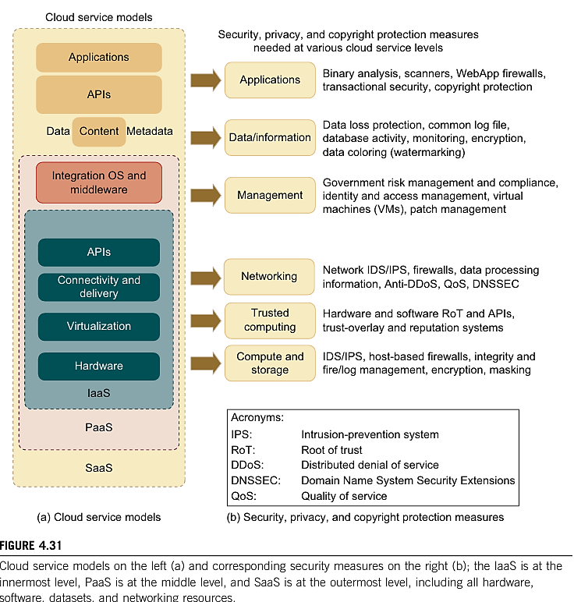

Slide 8
Basic Cloud Security
Here are some cloud components that demand special security protection:
Protection of servers from malicious software attacks such as worms, viruses, and malware
Protection of hypervisors or VM monitors from software-based attacks and vulnerabilities
Protection of VMs and monitors from service disruption and DoS attacks
Protection of data and information from theft, corruption, and natural disasters
Providing authenticated and authorized access to critical data and services

Slide 9
Security Challenges in VMs
In a cloud environment, newer attacks may result from hypervisor malware, guest hopping and hijacking, or VM rootkits.
Another type of attack is the man-in-the-middle attack for VM migrations.
In general, passive attacks steal sensitive data or passwords.
Active attacks may manipulate kernel data structures which will cause major damage to cloud servers.
An IDS can be a NIDS or a HIDS.
Notes:
Hypervisor malware targets the software layer (hypervisor) that manages VMs. If compromised, all hosted VMs are at risk.
Guest hopping happens when a malicious VM accesses data or services of another VM on the same host.
Hijacking involves taking control of a VM or hypervisor, allowing the attacker to perform unauthorized actions.

Slide 10
Cloud Defense Methods
Virtualization enhances cloud security. But VMs add an additional layer of software that could become a single point of failure.
With virtualization, a single physical machine can be divided or partitioned into multiple VMs (e.g., server consolidation).
This provides each VM with better security isolation and each partition is protected from DoS attacks by other partitions.
Security attacks in one VM are isolated and contained from affecting the other VMs.
Table 4.9 lists eight protection schemes to secure public clouds and data centers.

Slide 11
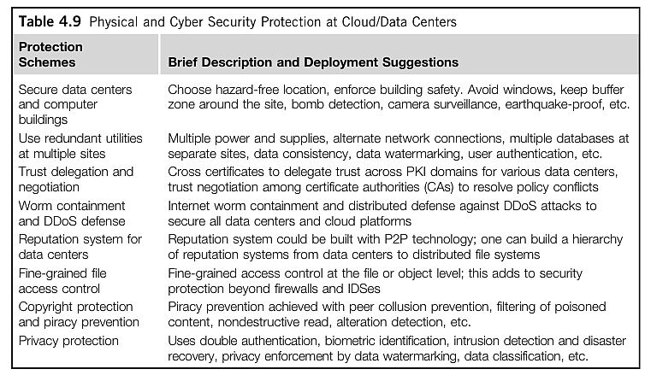
Cloud Defense Methods

Slide 12
Defense with Virtualization
The VM is decoupled from the physical hardware.
The entire VM can be represented as a software component and can be regarded as binary or digital data.
The VM can be saved, cloned, encrypted, moved, or restored with ease.
VMs enable High Availability and faster disaster recovery.
Multiple IDS (Intrusion Detection Systems) VMs can be deployed at various resource sites including data centers.

Slide 13
Privacy and Copyright Protection
The user gets a predictable configuration before actual system integration.
Yahoo!’s Pipes is a good example of a lightweight cloud platform. With shared files and data sets, privacy, security, and copyright data could be compromised in a cloud computing environment.
Users desire to work in a software environment that provides many useful tools to build cloud applications over large data sets.
Google’s platform essentially applies in-house software to protect resources.
The Amazon EC2 applies HMEC and X.509 certificates in securing resources.
It is necessary to protect browser-initiated application software in the cloud environment.

Slide 14
Privacy and Copyright Protection
Here are several security features desired in a secure cloud
Dynamic web services with full support from secure web technologies
Established trust between users and providers through SLAs and reputation systems
Effective user identity management and data-access management
Single sign-on and single sign-off to reduce security enforcement overhead
Auditing and copyright compliance through proactive enforcement
Shifting of control of data operations from the client environment to cloud providers
Protection of sensitive and regulated information in a shared environment

Slide 15
Cloud Security Safeguarded by Gateway and Firewalls
Figure 4.32 shows a security defense system for a typical private cloud environment.
The gateway is fully secured to protect access to commercial clouds that are wide open to the general public.
The firewall provides an external shield. The gateway secures the application server, message queue, database, web service client and browser with HTTP, JMS, SQL, XML, and SSL security protocols, etc.
The defense scheme is needed to protect user data from server attacks.
A user’s private data must not be leaked to other users without permission.

Slide 16
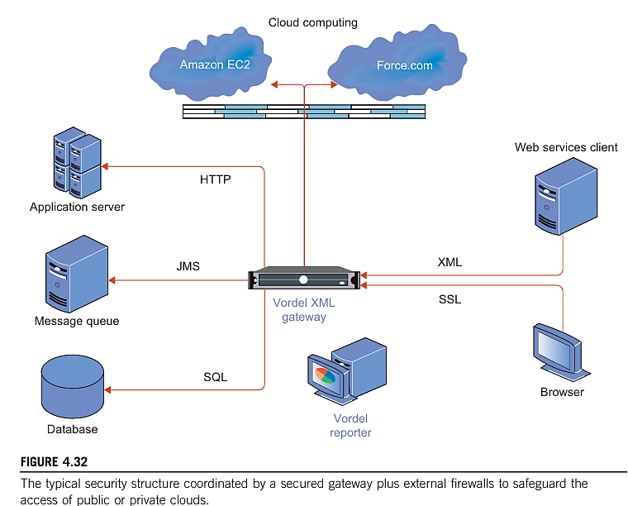
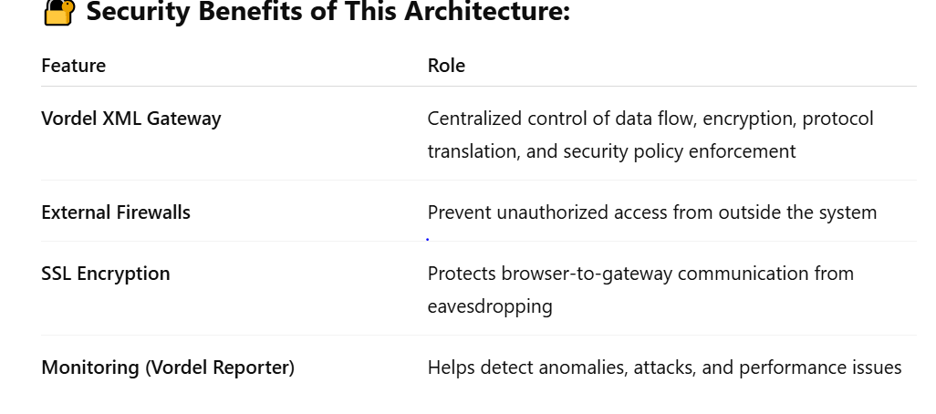
Notes:
Vordel XML Gateway (Central Security Hub)
Acts as the security enforcement point for incoming/outgoing traffic.
This setup ensures that all data going in or out of the cloud environment is filtered, validated, encrypted, and logged, which is critical for enterprise-level cloud security.
Would you like a simplified version of this architecture as a clean diagram for your paper or presentation?
Supports:
XML parsing
Protocol conversion (e.g., HTTP to JMS, XML to SQL)
Policy enforcement (authentication, authorization, throttling)
Vordel Reporter
Monitors and logs traffic flowing through the Vordel XML Gateway.
Useful for:
Auditing
Intrusion detection
Performance monitoring

Slide 17
Distributed Intrusion/Anomaly Detection
Data security is the weakest link in all cloud models.
Security threats may be aimed at VMs, guest OSes, and software running on top of the cloud.
IDSs attempt to stop these attacks before they take effect.
Both signature matching and anomaly detection can be implemented on VMs dedicated to building IDSes.
Signature-matching IDS technology is more mature, but require frequent updates of the signature databases.
Network anomaly detection reveals abnormal traffic patterns, such as unauthorized episodes of TCP connection sequences against normal traffic patterns.
Distributed IDSs are needed to combat both types of intrusions.

Slide 18
Distributed Defense against DDoS Flooding Attacks
A DDoS defense system must be designed to cover multiple network domains spanned by a given cloud platform.
These network domains cover the edge networks where cloud resources are connected. DDoS attacks come with widespread worms.
The flooding traffic is large enough to crash the victim server by buffer overflow, disk exhaustion, or connection saturation.
Figure 4.33(a) shows a flooding attack pattern. Here, the hidden attacker launched the attack from many zombies toward a victim server at the bottom router R0.
The flooding traffic flows essentially with a tree pattern shown in Figure 4.33(b). Successive attack-transit routers along the tree reveal the abnormal surge in traffic.

Slide 19
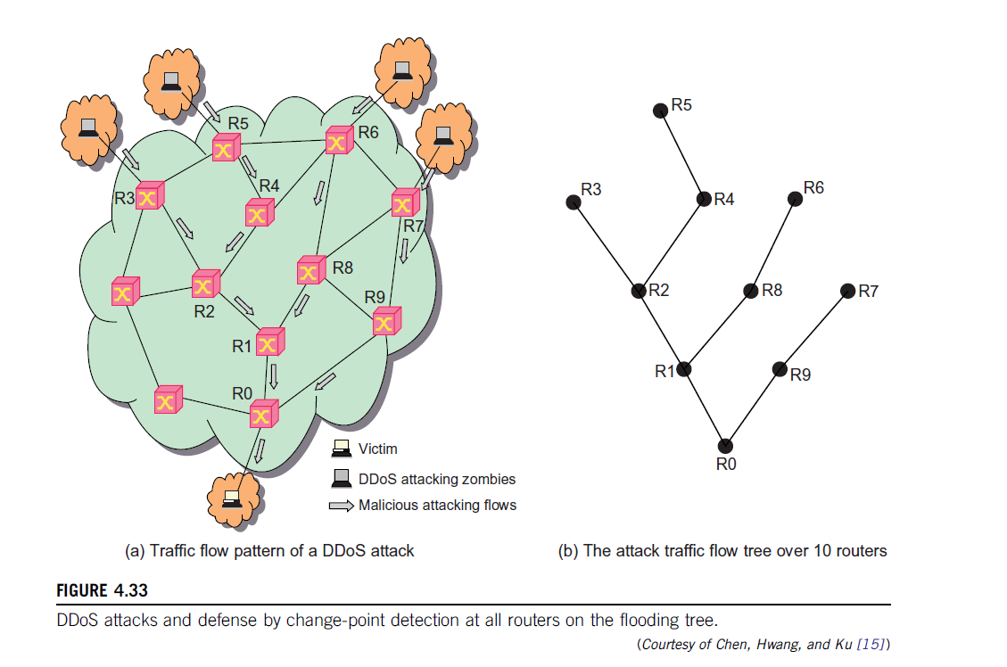

Slide 20
Data and Software Protection Techniques
Data Integrity and Privacy Protection
Users desire a software environment that provides many useful tools to build cloud applications over large data sets. In addition to application software for MapReduce, BigTable, EC2, 3S, Hadoop, AWS, GAE, and WebSphere2, users need some security and privacy protection software for using the cloud.
Such software should offer the following features:
  Special APIs for authenticating users and sending e-mail using commercial accounts
  Fine-grained access control to protect data integrity and deter intruders or hackers
  Shared data sets protected from malicious alteration, deletion, or copyright violation Ability to secure the ISP or cloud service provider from invading users’ privacy
  Personal firewalls at user ends to keep shared data sets from Java, JavaScript, and ActiveX applets
  A privacy policy consistent with the cloud service provider’s policy, to protect against identity theft, spyware, and web bugs
  VPN channels between resource sites to secure transmission of critical data objects

Slide 21
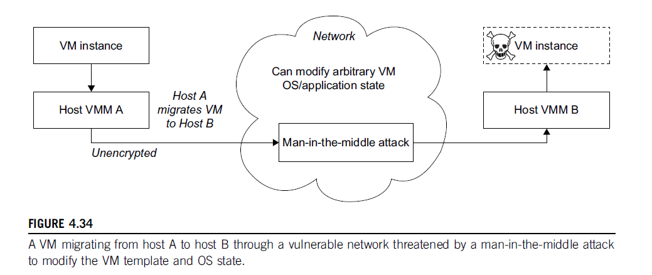

Slide 22
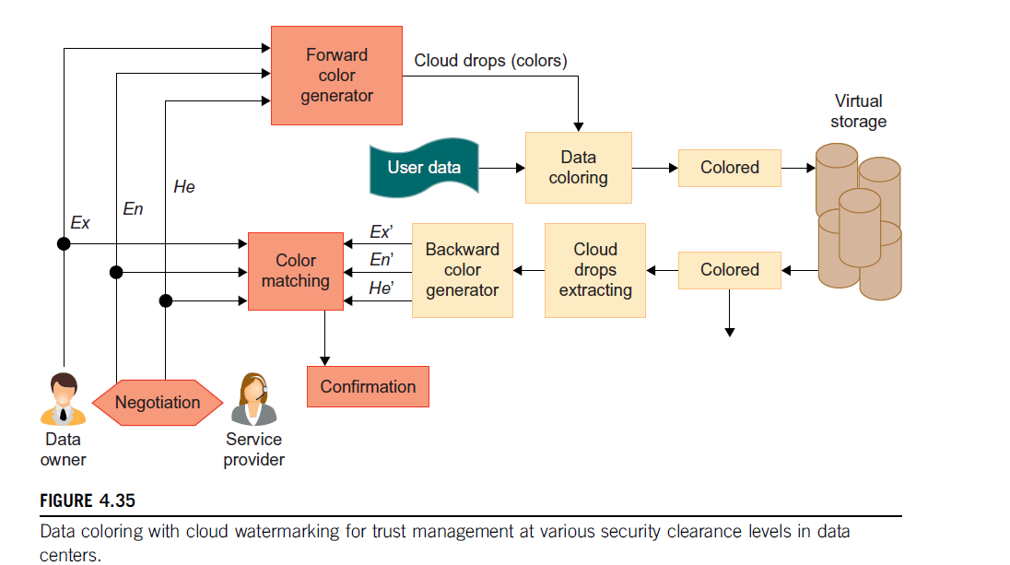
Data Coloring and Cloud Watermarking

Slide 23
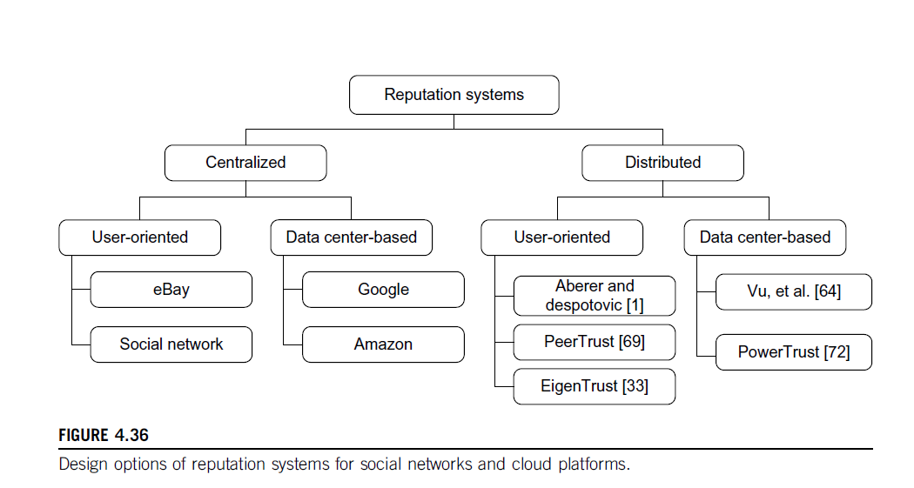
Reputation-Guided Protection of Data Centers
Reputation System Design Options
Public opinion on character (honest behavior or reliability) of an entity could be reputation of a person, an agent, a product, or a service.
To address reputation systems for cloud services, a systematic approach is based on the design criteria and administration of reputation systems.
Reputation systems are classified as centralized or distributed.
Reputation-based trust management and techniques for securing P2P and social networks could be merged to defend data centers and cloud platforms against attacks from the open network.

Slide 24
Trust Overlay Networks
Trust overlay could be structured with a distributed hash table (DHT) to achieve fast aggregation of global reputations from a large number of local reputation scores.
At the bottom layer is the trust overlay for distributed trust negotiation and reputation aggregation over multiple resource sites.
This layer handles user/server authentication, access authorization, trust delegation & data integrity control.
At the top layer is an overlay for fast virus/worm signature generation & dissemination and for piracy detection.
This overlay facilitates worm containment & IDSes against viruses, worms, & DDoS attacks.
The security-aware cloud architecture is specially tailored to protect virtualized cloud infrastructure.

Slide 25
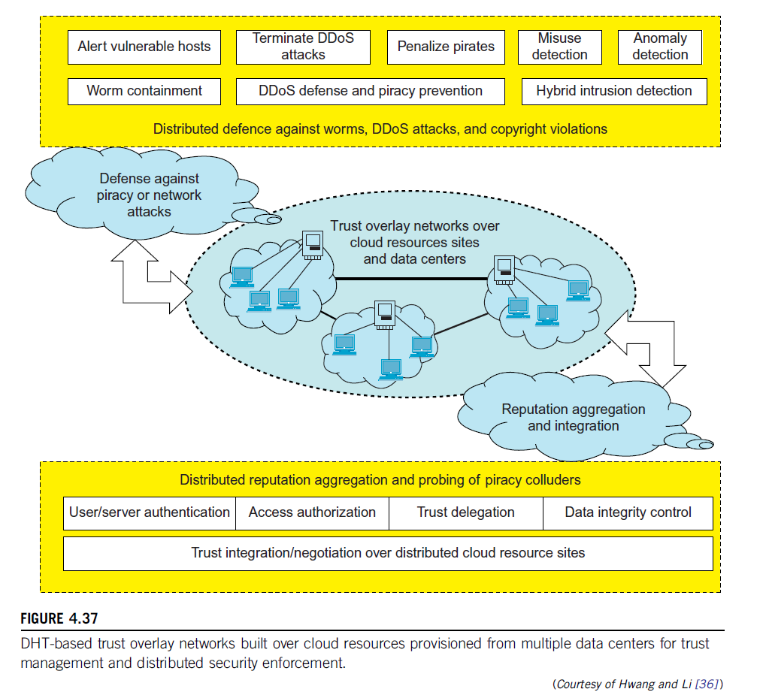

Slide 26
Recollect Quiz
VMs enable __________________ and _______________________.
Yahoo!’s Pipes is a good example of a ________________________.
______________ is the weakest link in all cloud models.
___________________ is used to reduce security enforcement overhead.
________________ and ________________ are the two types of reputation systems.
Notes:
1. High Availability and faster disaster recovery
2. lightweight cloud platform
3. Data Security
4. Single sign-on and single sign-off
5. Centralized and Distributed
5.

Slide 27
Possible Questions in the IAT/Exam
List and explain the eight protection schemes to secure public clouds and data centers.
What is a flooding DDoS attack pattern? .
What is Data Intensive Computing(DIC)? List all the challenges in DIC and explain in detail.
List and explain the top 5 best practices in Cloud Security.
List and explain the key features of Google with security guarantees.
Notes:
1. High Availability and faster disaster recovery
2. lightweight cloud platform
3. Data Security
4. Single sign-on and single sign-off
5. Centralized and Distributed
5.

Slide 28
THANK YOU

